Slide 1

We don’t just go with the flow, we create it.

Slide 2

Pump Basics
What are we talking about
Our focus has been to educate and make our distributors aware of our MP Pumps, Inc. products, markets, and applications.
This webinar has come about from the feed back we have received from you our distributors.
  Key terms and definitions
  Application Data
  Pump Curves
  Beyond the pumps
  Trouble shooting
  What’s new

Slide 3
Pump Basics
Key Terms and Definitions
Flow- liquid volume capacity of a pump stated in gpm or gph
Head- measure of pressure expressed in feet. Indicates the height of a column of water being lifted by a pump (neglecting friction losses in the piping)
Total Head- sum of discharge head, suction head, and friction losses
Atmospheric Pressure- 1 psi = 2.31 ft of water
Suction lift- Occurs when the liquid source is lower than the pump. Pumping action creates a partial vacuum and atmospheric pressure forces liquid up to the pump

Slide 4
Pump Basics
Key Terms and Definitions
NPSH- amount of atmospheric pressure available to push the liquid into a pump.
  NPSHa
  NPSHr
Specific Gravity- the ratio of the weight of a given volume of liquid to the same volume of pure water.
  Water is 8.3 lb./gal.
Viscosity- the thickness of a liquid affecting its ability to flow.
Cavitation- the rapid formation and collapse of vapor pockets (bubbles) in a flowing liquid in regions of very low pressure

Slide 5
Pump Basics
Application Data
Understanding these terms will help us to properly apply centrifugal pumps in applications brought our way.
Keys to accurate pump application
  Gather as much data as possible
  Asking the right questions
  Doing the research that may be necessary
  Using available tools
  Accurately apply the data given

Slide 6
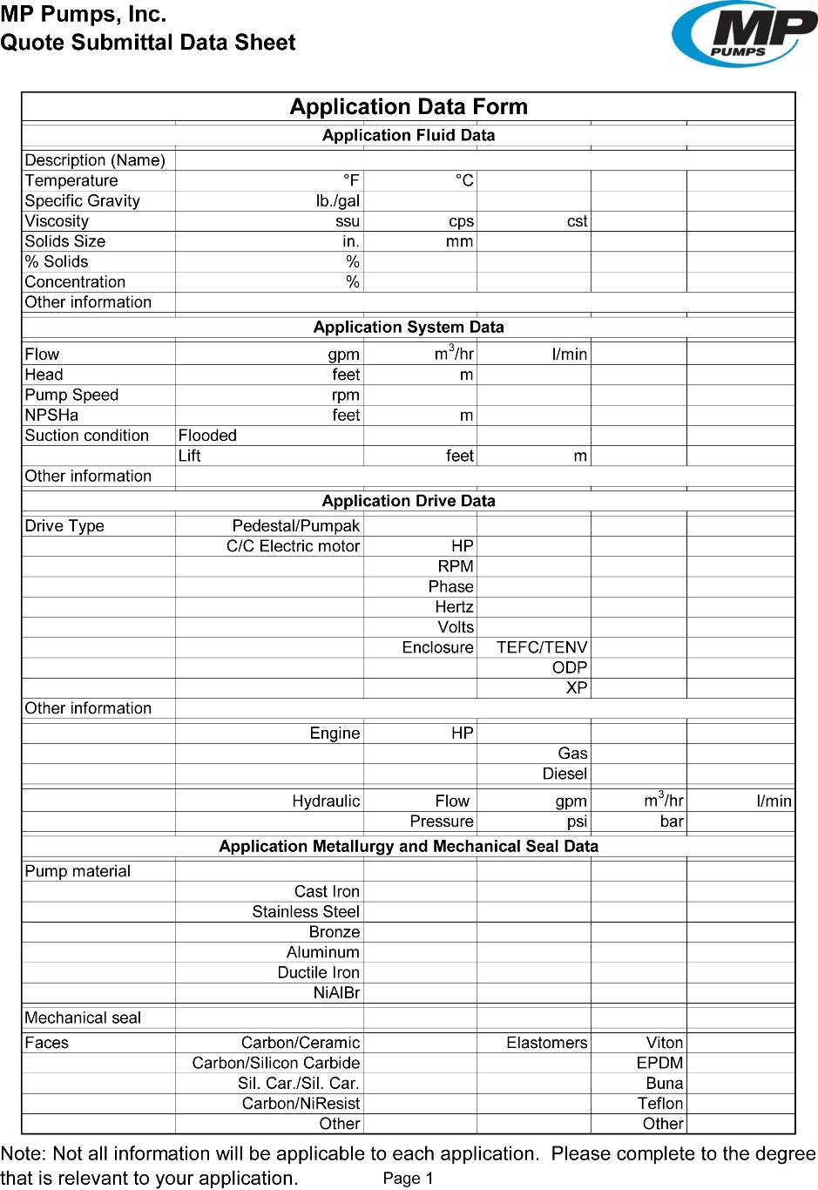
Pump Basics
Application Data Sheet

Slide 7
Pump Basics
Asking the right questions
Start at the beginning
  Flooded suction or lift condition
    Lift required
  Application fluid
    Temperature
    Solids
    Abrasive
    Concentration
  Flow and head required
    Pump speed

Slide 8
Pump Basics
Asking the right questions
Drive requirements
  Pedestal or Pumpak
  Electric motor/Engine/Hydraulic
  Horsepower restrictions
  Voltage/Hertz requirements
  Enclosure requirements
Metallurgy
  Cast Iron/SS/ Bronze/NiBrAl

Slide 9
Pump Basics
Asking the right questions
Mechanical seal requirements
  Standard is carbon/ceramic/Viton
  Chemical compatibility
  Abrasive fluid
  Single or double seal
Using the Pump Curves
  Speed
  Impeller Trims
  Priming Lines
  NPSH
  Efficiency

Slide 10










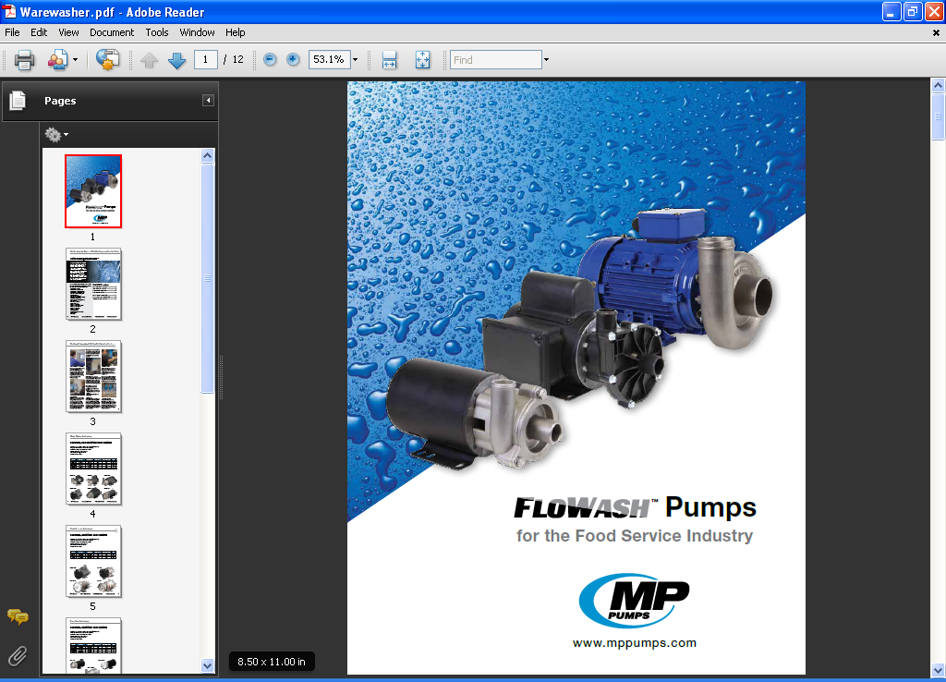

Product Line
™
™

Slide 11
Pump Basics
Pump Curves

Slide 12
Pump Basics
Pump Curves

Slide 13
Pump Basics
Pump Curves

Slide 14
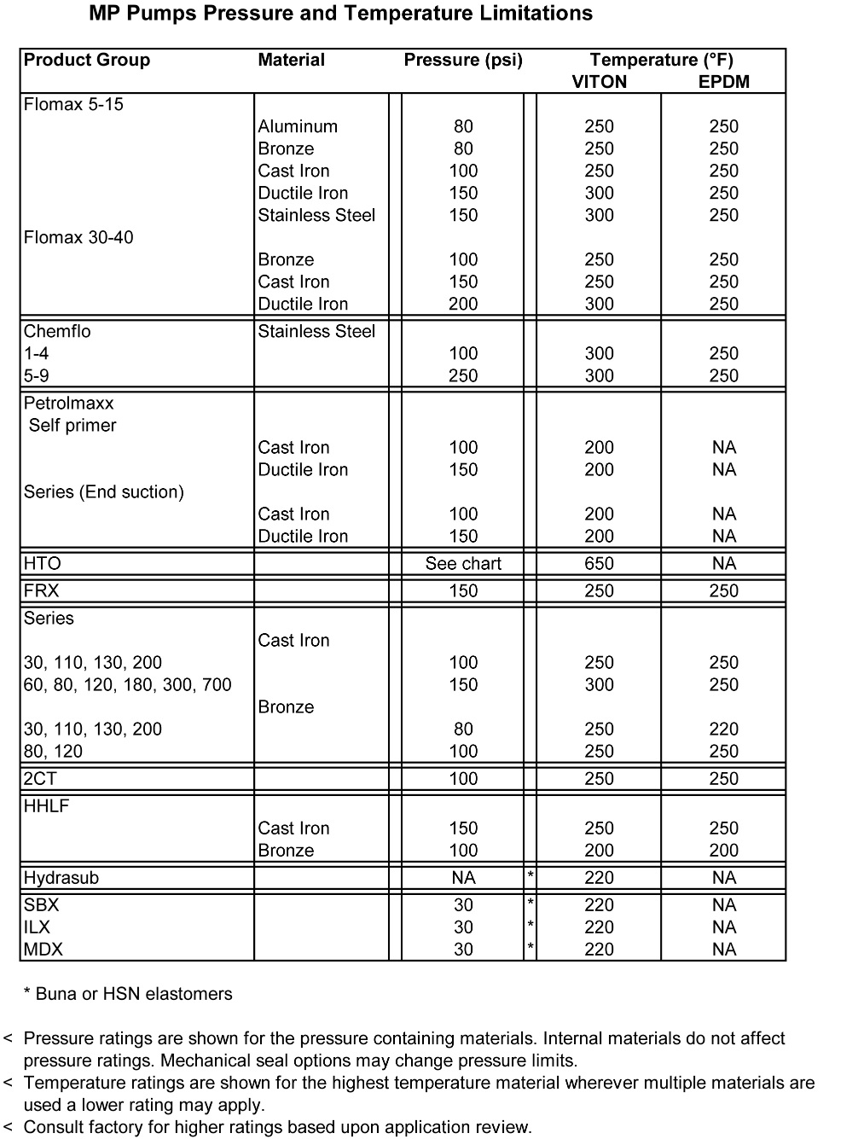
Pump Basics
Pressure and Temperature limits

Slide 15
Pump Basics
Other Key Considerations
Specific Gravity- effects the HP requirements required for the pump to obtain a given duty point
Viscosity- the resistance to flow may effect the flow, head, and efficiency for a given application
  Viscosity correction factors from hydraulic handbook
  Open vs. Closed impeller
Flanged vs. Threaded connections
Minimum flow- not less than 10% of BEP

Slide 16
Pumps Basics
Where to find important information
Our website: www.mppumps.com
You can find:
Sales literature
Product data sheets
Performance curves
Exploded view parts drawings
Pricing information
How to videos
Webinar slide presentations

Slide 17
Pump Basics
Beyond the pumps
Instrumentation
  Can play a key role in quickly diagnosing pump performance issues
Pressure gages
Flow meters
  Timed tank level readings
  How long does it take to transfer the product
Temperature gages
Isolation valves

Slide 18
Pump Basics
Troubleshooting
Self-priming pump priming issues:
  Was pump filled initially
  Impeller to wear plate clearance
  Check valves in the discharge line
  Duty point beyond the lift capability of the pump
  Direction of rotation
  Clogged suction line
  Air leaks in the suction side
  If hose is used is it rated for suction use

Slide 19
Pump Basics
Troubleshooting
Mechanical seal failures
  Did the pump run dry
  Correct impeller to wear plate clearance sets the correct seal working height
  Incorrect application for materials of construction
  Abrasives
  Selected materials correct for the chemical concentration

Slide 20
Pump Basics
Troubleshooting
Pumpak installation
  Shim material provided in the pumpak from the factory
  Shim material maintains the proper impeller clearance during assembly
  Number one reason for incorrect setting of the impeller clearance is that the shim material is removed prior to mounting the pumpak
  Incorrect impeller clearance can lead to inadequate performance and shortened seal life

Slide 21
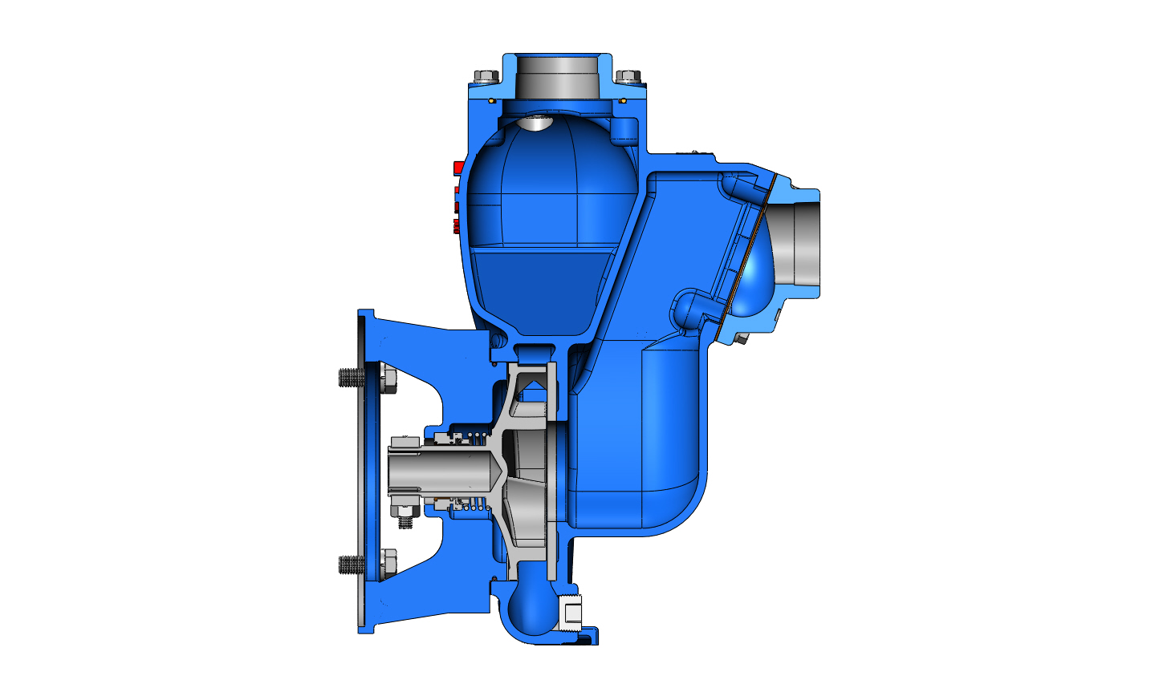

Slide 22
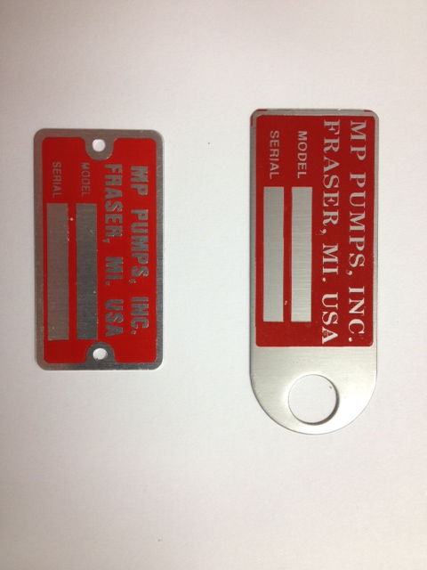

Pump Basics
Name Plate Data

Slide 23
Pump Basics
Name Plate Data
MP Pumps name plates contain the following information
Model #: 5 digit number (this is different than the description) 21381
Serial # : combination of numbers and letters (i.e. 11A0678)
11 Year of manufacturer
A Month code
0678 678th pump manufactured in a given month

Slide 24
What are we talking about?
MP Pump Abbreviations
Pump model and size
MP part #
Any additional features
Pump or Pumpak
21339 FM8 PMP C: PED 5.0 ??? ??? ??
Housing material of construction
Impeller diameter
How the pump is driven

Slide 25
What are we talking about?
MP Pump Abbreviations
Pump model and size
Any additional features
MP part #
Pump or Pumpak
31383 CF5 PPK SS: 184TC 6.18 T-2100 ??? ???
Housing material of construction
Impeller diameter
How the pump is driven

Slide 26
What are we talking about?
MP Pump Abbreviations
Pump model and size
Special mechanical seal
MP part #
Pump or Pumpak
33700 HTO 80 PMP D: 3-3 56C 5.9 T-2 NRS FF HD
Housing material of construction
Impeller diameter
Any additional features
How the pump is driven

Slide 27
Pump Basics
What’s new…
Addition of “How to videos”
  How to install a Pumpak
  How to replace a mechanical seal
  How to set the clearance on a Flomax pumps
  How to set the clearance properly on a HTO pump
  New and improved Flomax 316 SS pumps!!

Slide 28
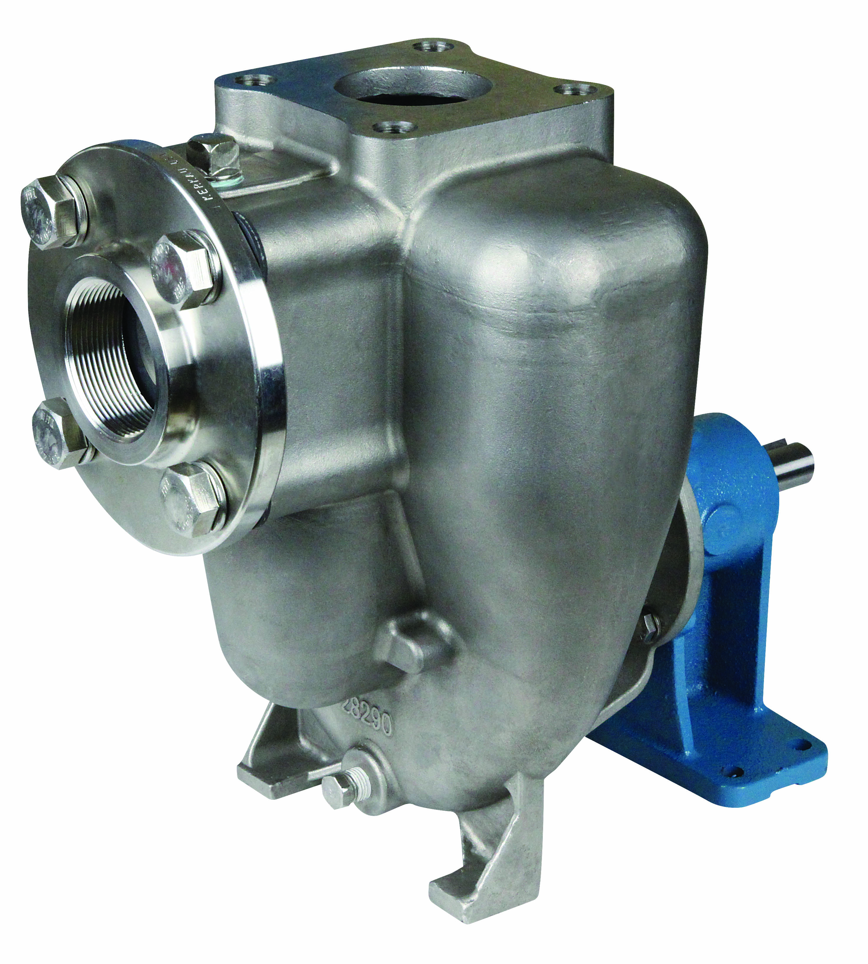

REDESIGNED FLOMAX® 8
Suction flange and Viton flapper valve now included
Larger suction port opening to allow for use of flapper valve
Wear plate holes are now blind holes, drilled and tapped
No more thru holes with acorn nuts and sealing washers
Fill port for ease of filling the priming chamber
Both ports are SAE 4-bolt flange decks
2” ANSI 150# 316 SS suction flange
Discharge flange kit available (p/n #36607) includes:
  2” ANSI 150# Discharge flange
  Viton gasket
  4 each , 316 SS capscrews and lockwashers
Now available with optional 5-blade 316 SS impeller

Slide 29
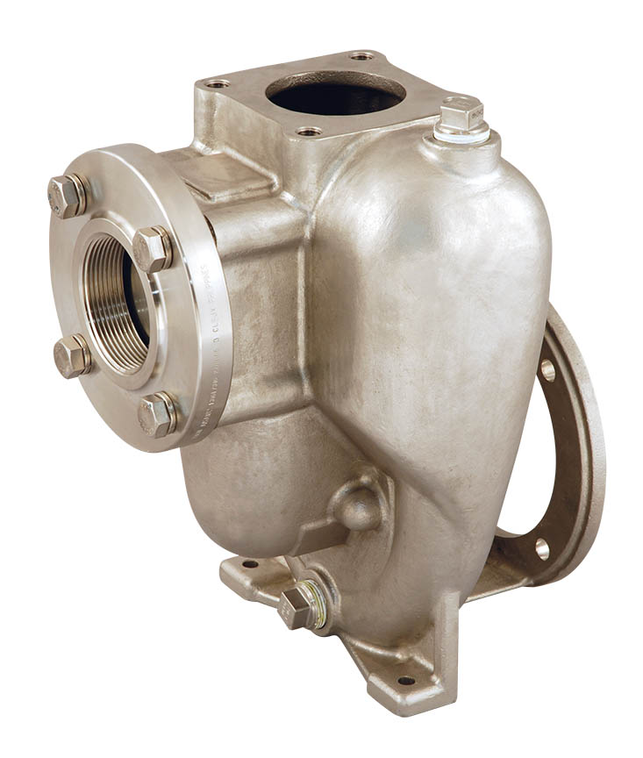

THE NEW FLOMAX® 15
New Housing design with:
  SAE 4 bolt flange decks
  Fill port for ease of filling the priming chamber
  Wear plate holes are now blind holes, drilled and tapped
  No more thru holes with acorn nuts and sealing washers
Suction flange and Viton flapper valve now included
3” ANSI 150# 316 SS suction flange
Discharge flange kit available (p/n #38647) includes:
  3” ANSI 150# Discharge flange
  Viton gasket
  4 each , 316 SS capscrews and lockwashers

Slide 30
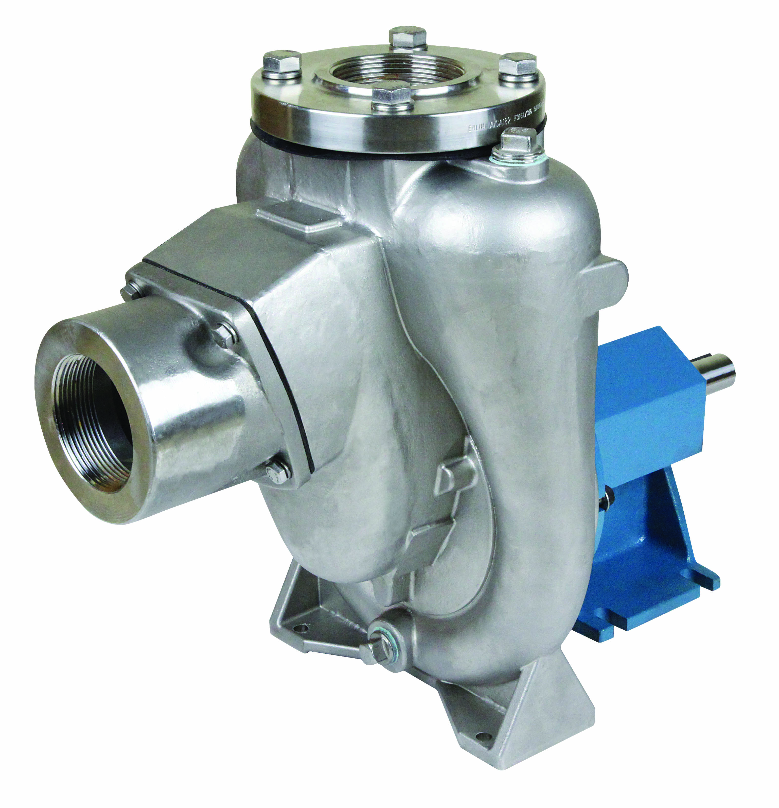
THE NEW FLOMAX® 30
Flomax 30 pumps are now available in 316 SS material
  Also available as a Flomax 35 (4” suction x 3” discharge)
3” FNPT suction port with a Viton flapper
SAE 4 bolt flange deck with 3” ANSI 150# 316 SS discharge flange and Viton gasket standard
Fill port for ease of initial priming
Wear plate holes are cast as blind holes then drill and tapped
No acorn nuts and sealing washers
Available as pedestal pump or pumpak
Pumpak option allows for customer versatility of supplying their own driver

Slide 31
Pump Basics
Wrapping up
Our website: www.mppumps.com
Our phone #: 1-800-563-8006
Let us know if you have a webinar idea
Thank you for attending our Pump Basics webinar!

